Slide 1
My State: Michigan

Slide 2
My state Nickname is The Great Lake State
The name Michigan is the French form of the Ojibwa word mishigamaa, meaning "large water" or "large lake.”

Slide 3
tree
White Pine

Slide 4
My state bird

Slide 5
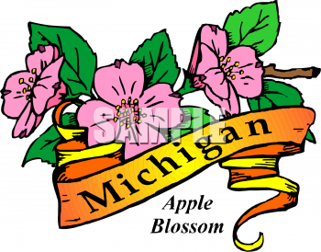
My Flpwer
Apple Blossom

Slide 6
My state animal is a wolverine

Slide 7
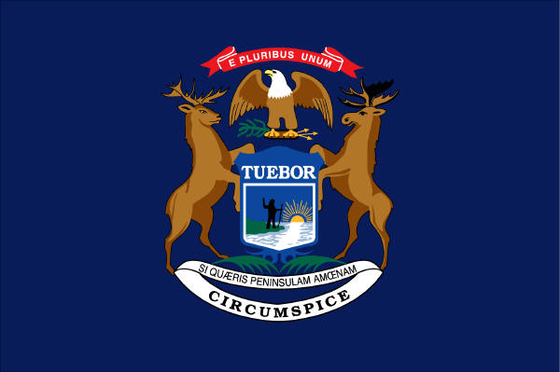
michigans Flag

Slide 8
My State Fish
Brook Trout

Slide 9
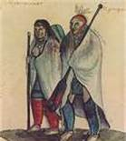
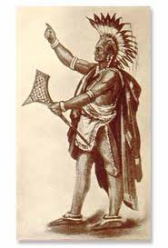
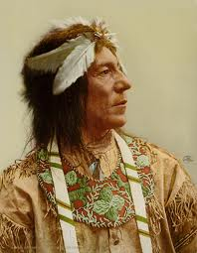
Our Early Michiganians
Algonquian peoples
Ottawa
Ojibwa

Slide 10
State History
French voyageurs and coureurs des bois explored and settled in Michigan in the 17th century. The first Europeans to reach what later became Michigan were those of Étienne Brûlé's expedition in 1622. The first permanent European settlement was founded in 1668 on the site where Père Jacques Marquette established Sault Ste. Marie, Michigan as a base for Catholic missions. Missionaries in 1671–75 founded outlying stations at Saint Ignace and Marquette. Jesuit missionaries were well received by the Indian populations in the area, with relatively few difficulties or hostilities. In 1679, Robert Cavelier, Sieur de la Salle built Fort Miami at present-day St. Joseph.

Slide 11
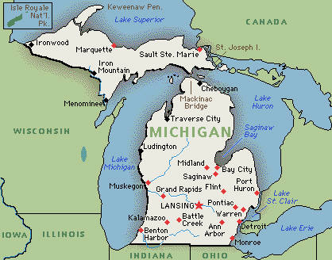
My Capital is Lansing

Slide 12
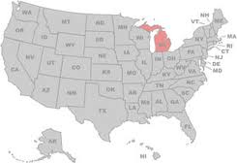
Michigan: Our Size & Location

Slide 13
Our State Song
Michigan, My Michigan
Written by: William Otto Miessner & Douglas M. Malloch
A song to thee, fair State of mine, Michigan, my Michigan;
But greater song than this is thine, Michigan, my Michigan;
The whisper of the forest tree, The thunder of the inland sea;
Unite in one grand symphony Of Michigan, my Michigan.
I sing a State of all the best, Michigan, my Michigan;
I sing a State with riches blest, Michigan, my Michigan;
Thy mines unmask a hidden store, But richer thy historic lore,
More great the love thy builders bore, Oh, Michigan, my Michigan.
.

Slide 14
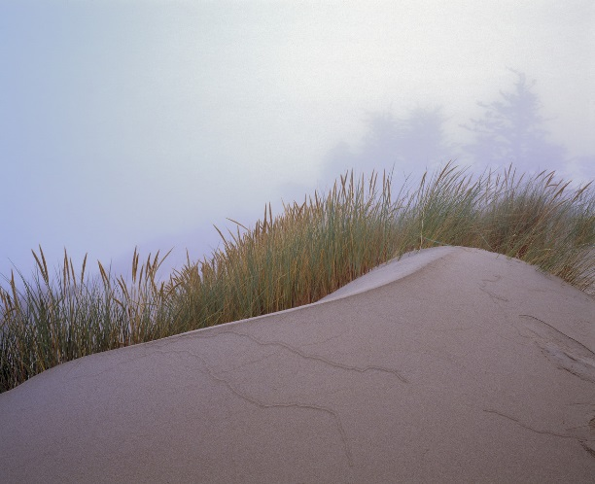
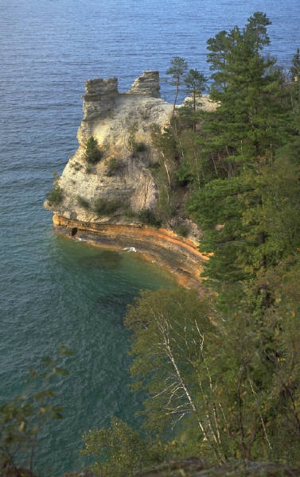
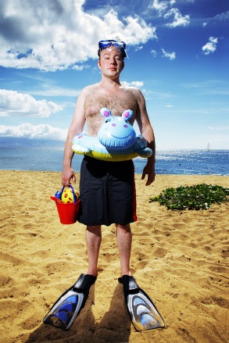
My Favorite Michigan Stuff
Traverse City Cherry Pie
Climbing
Sleeping Bear Dunes
Hiking and Camping
golfing
Swimming in
Lake Michigan
Fishing in the lakes

Slide 15

Visit www.michigan.gov

